Slide 1
Read, Retrospect, Select: An MRC Framework to Short Text Entity Linking
AAAI 2021
2021.08.22 • ChongQing
Reported by Chenghong Li

Slide 2
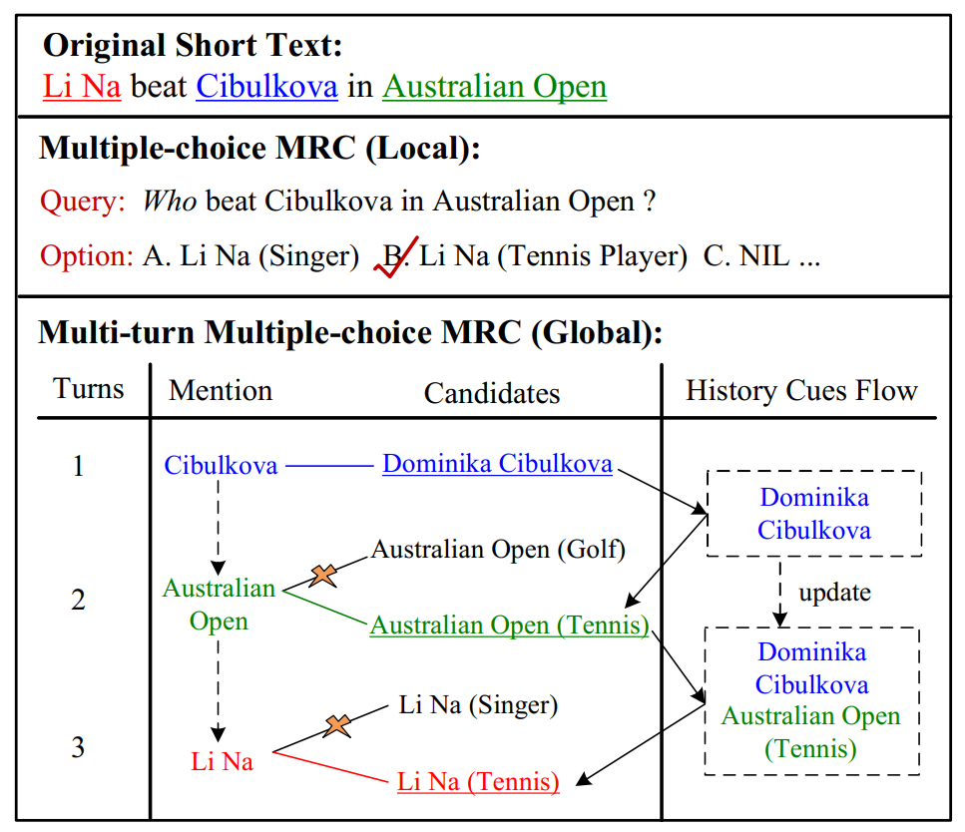
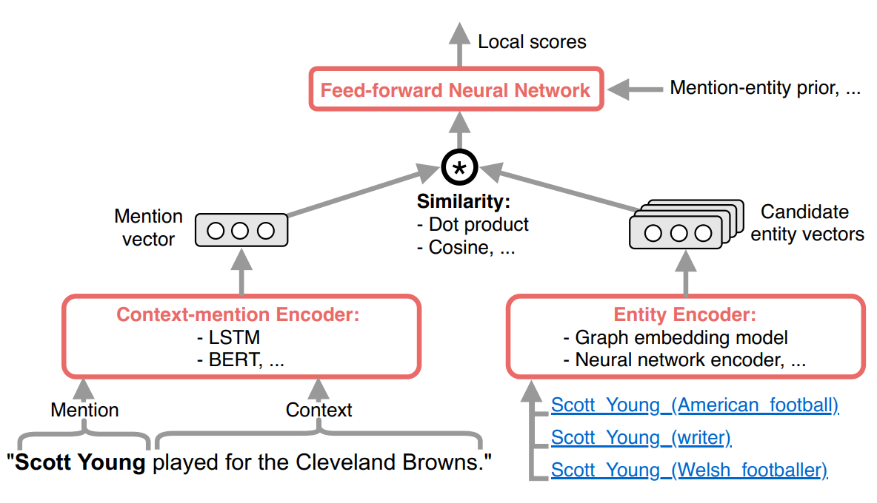
Introduction
Sevgili et al. / Neural Entity Linking: A Survey of Models Based on Deep Learning
arXiv:2006.00575

Slide 3
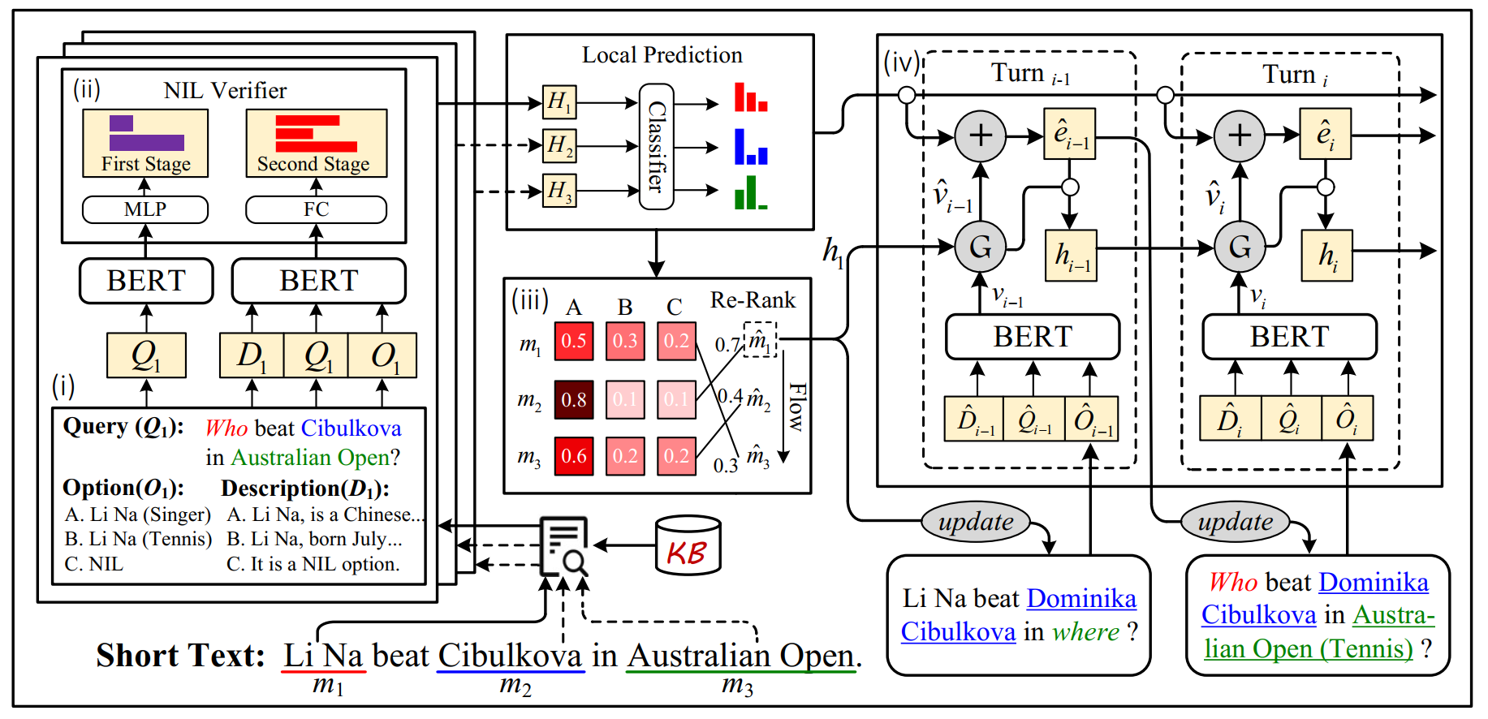
Method

Slide 4
Method

Slide 5
Method

Slide 6
Method

Slide 7
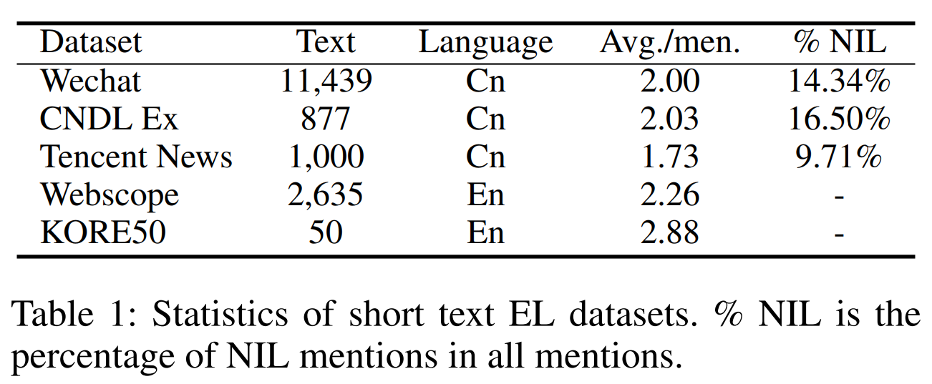
Experiments

Slide 8
Experiments

Slide 9
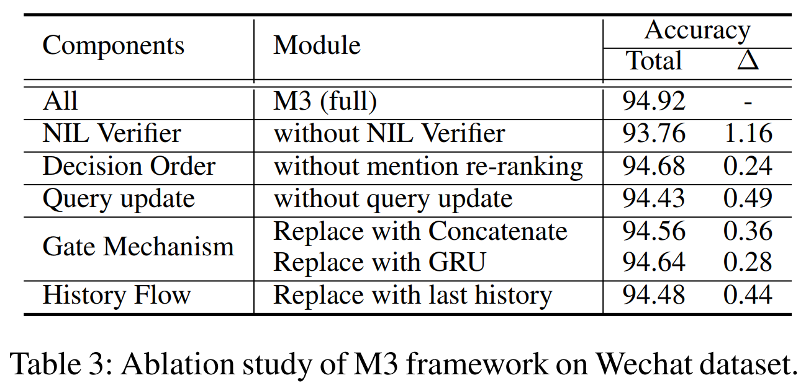
Experiments

Slide 10
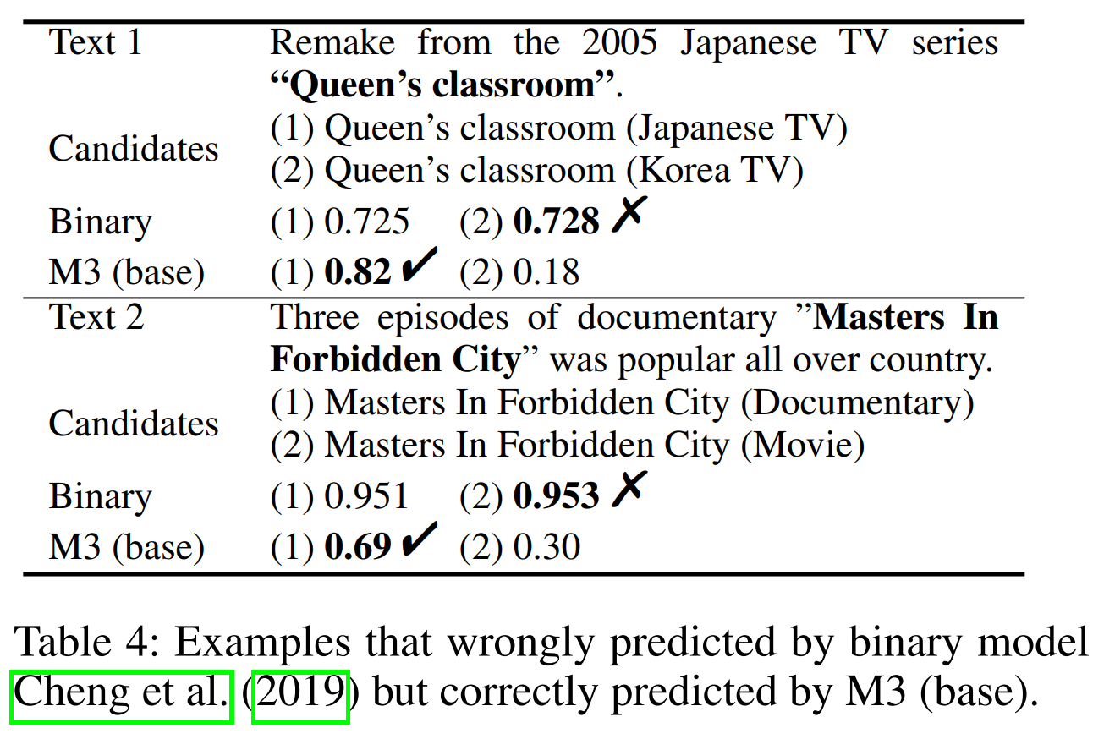
Experiments

Slide 11
Thanks

